Slide 1
Lesson 2.3. GIT
Previous Lesson: 1. IDEs 2. VIM 3. Basic VIM commands 4. Created a file and edited it with VIM
Module 2. Setting up Environment (directory)
Lesson 1. Command-line Interface (directory)
My new file.txt (file .txt)
Lesson 2. VIM (directory)
vim.txt (file .txt)

Slide 2


Lesson 2.3. GIT
How developers store and manage files and folders? - Store all the files and folders on your computer? - Use Google Drive, Dropbox or similar cloud storages? Today developers use Version Control Systems, which allows you to: - Store your files and folders in the internet - Save all your code version history and recover if needed - Share it with people, employer or teammates - Work in a team on a project - Look at other people’s code (if it is public) - Search for teammates - And a lot of other staff Git is a Version Control System Github – is a hosting for storing repositories (or let’s call it project folders), based on Git technology

Slide 3
Lesson 2.3. GIT
Why we will use Github: - It is one of the most popular developer tools - Basic functions (which we will need) are very simple - It can be used with CLI - It will give you GIT skill, which is nowadays mandatory for all developers - You will be able to save all your code there and share it with your employer if needed

Slide 4
Lesson 2.3. GIT
How to set up github: - Go to https://github.com/ and sing up - Select a FREE plan - Verify your account’s email address - Create your first repository (project folder). Let’s call it “ProgrammingForBeginners” - Copy url - Open Terminal - Type git clone <url> and you will see your repository’s folder will be created - Go to this directory with command cd <repository name> - Move our folders to repository folder (You can do it with GUI or CLI with command mv) - Type “git add .” – which is adding all the content of the “Course” folder (Lesson 1, Lesson 2 folders and content in them also) to your repository - Type “git commit –m “any comment you want”” – this will commit changes if there were any and assign a comment to your commit. (to commit – is to add latest changes of your code to your repository” - Type git push to upload all the folders and files to your repository on github - enter your username at github.com - enter your password at github.com

Slide 5
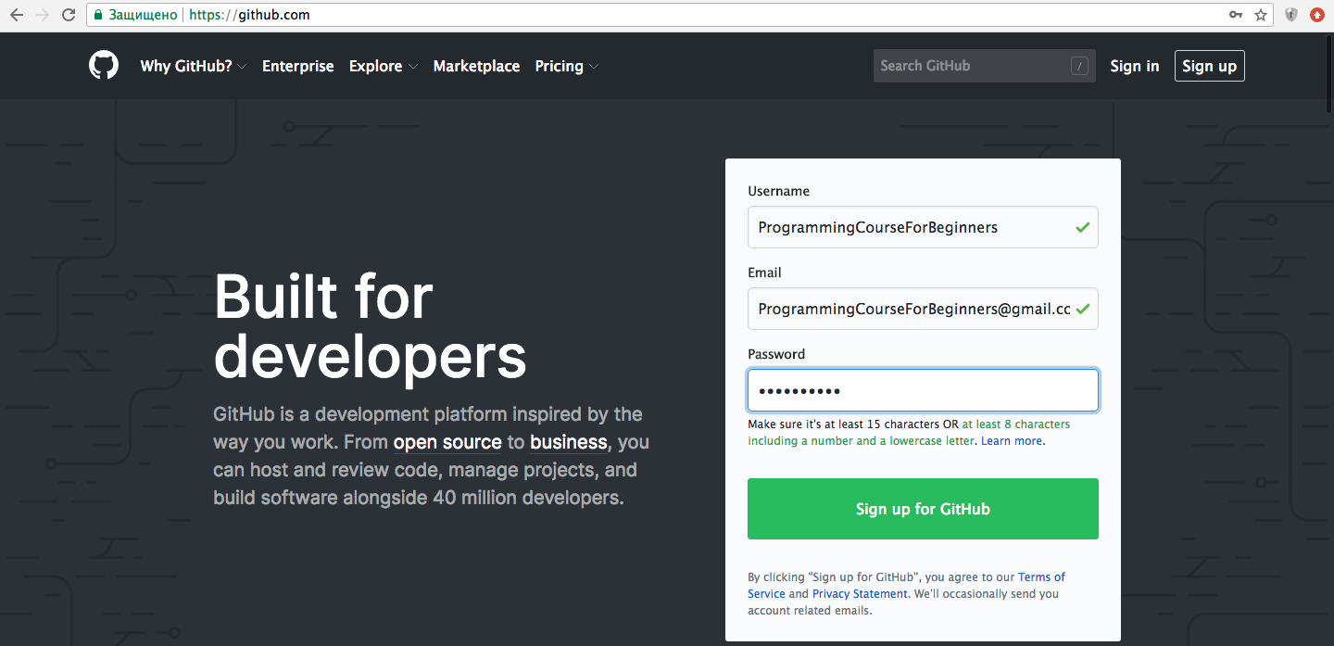
Lesson 2.3. GIT
Step 1. Go to https://github.com/ and sing up

Slide 6
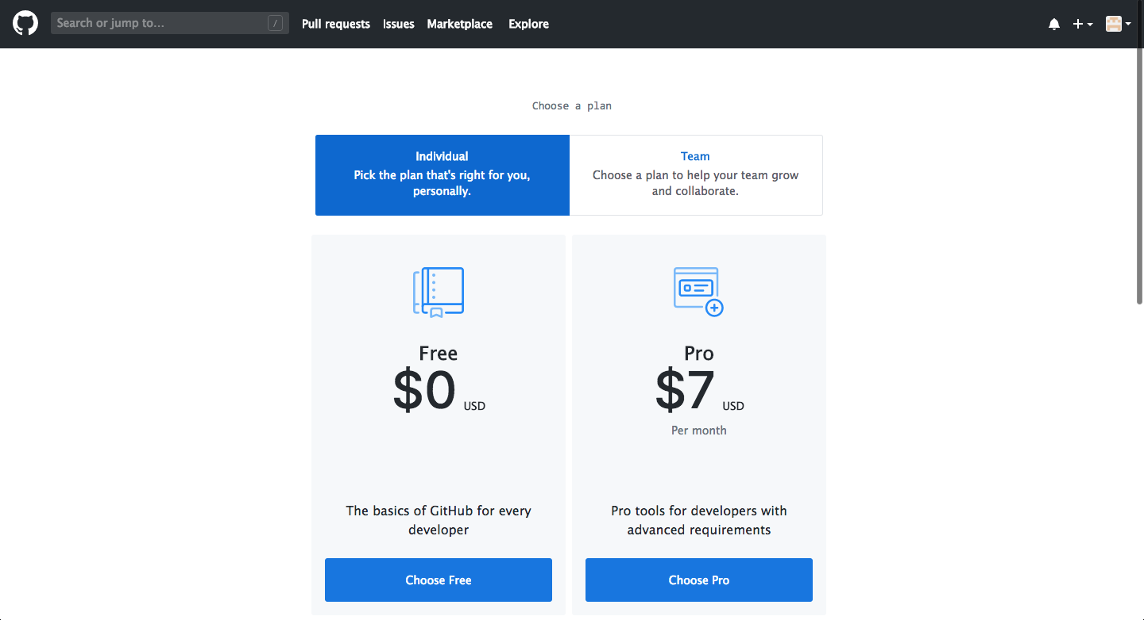
Lesson 2.3. GIT
Step 2. Select a FREE plan

Slide 7
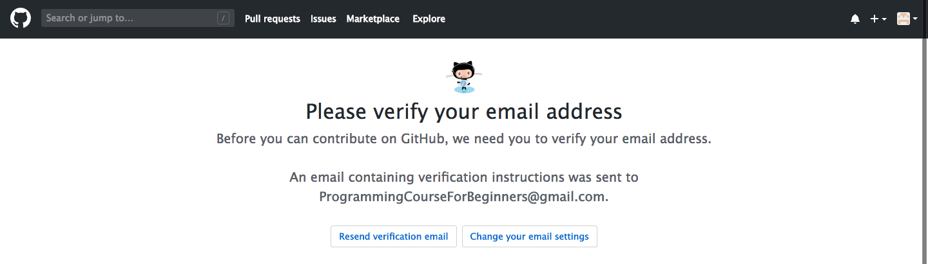
Lesson 2.3. GIT
Step 3. Verify your account’s email address

Slide 8
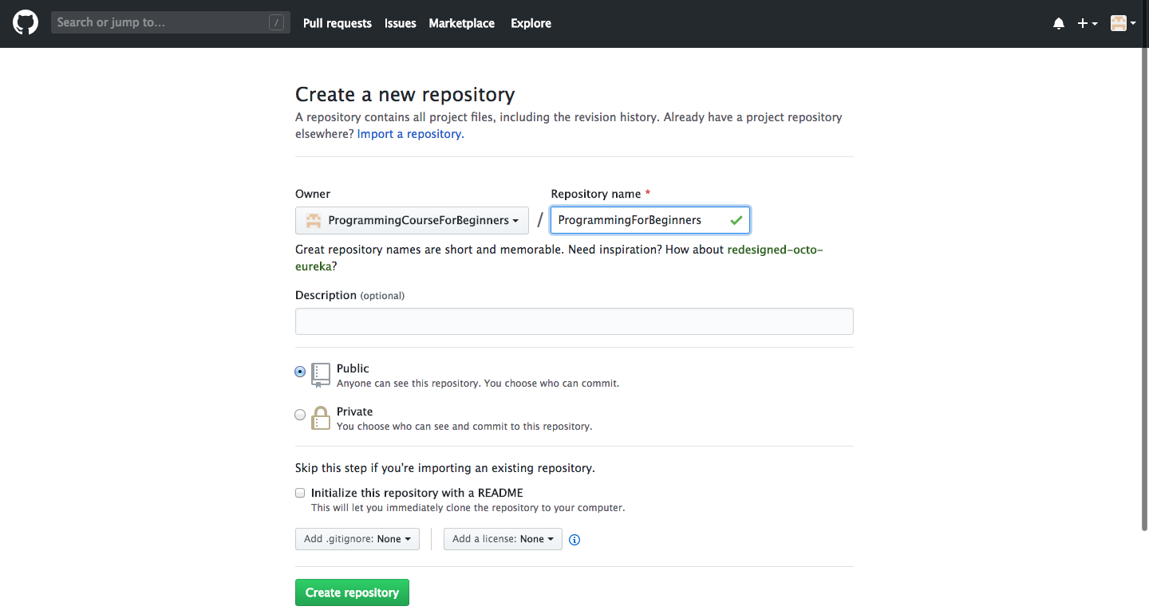
Lesson 2.3. GIT
Step 4. Create your first repository (Project folder). We will use 1 folder for the whole course, so you can name it for example “ProgrammingForBeginners” Choose “Public” and create

Slide 9
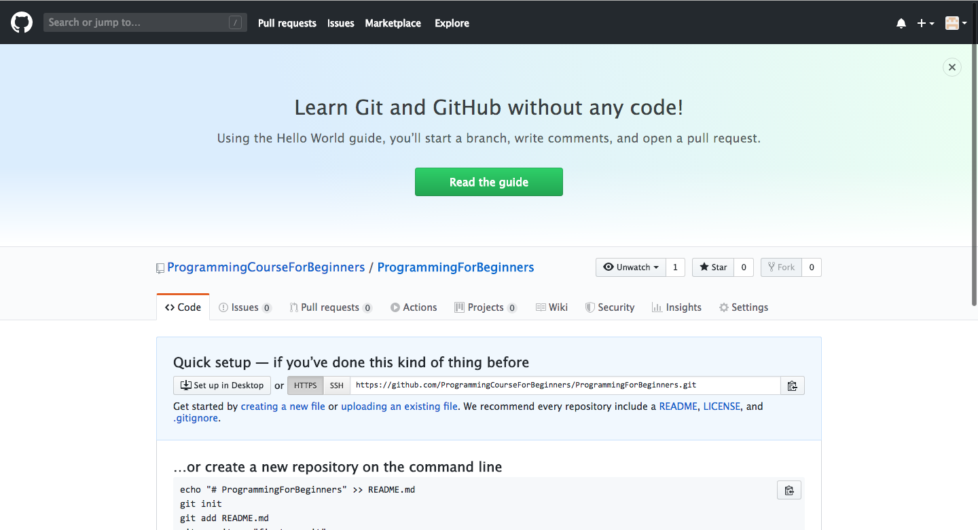
Lesson 2.3. GIT
Step 5. Copy url

Slide 10
Lesson 2.3. GIT
Step 5. Copy url

Slide 11
Lesson 2.2. VIM
Homework: 1. Add folder and file to the current structure
2. Insert text “Hello” in vim.txt file 3. Write changes and quit
Module 2. Setting up Environment (directory)
Lesson 1. Command-line Interface (directory)
My new file.txt (file .txt)
Lesson 2. VIM (directory)
vim.txt (file .txt)

Slide 12
Lesson 2.2. VIM
Recap: 1. IDEs 2. VIM 3. Basic VIM commands 4. Created a file and edited it with VIM

